Slide 1
Business case
Introduction
Opened 7 years ago
Gourmet restaurant
Serve good food
Management summary
Conclusion

Slide 2
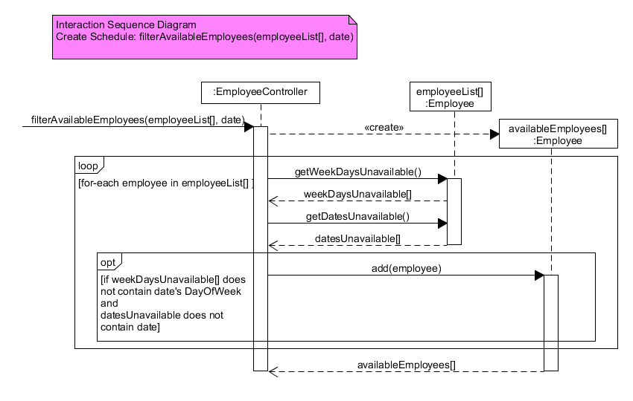
ISD filterAvailableEmployees

Slide 3
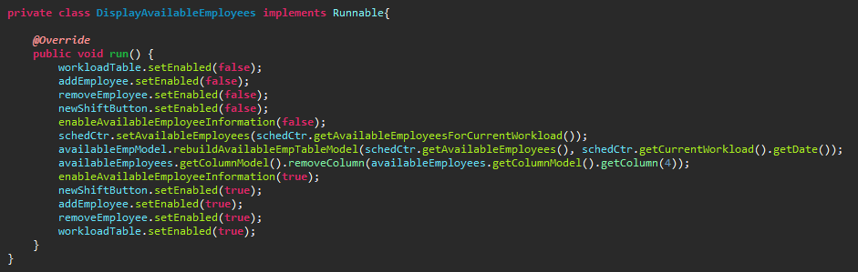
Multithreading

